Slide 1

DeepLAW

Slide 2

Imagine situation

Slide 3
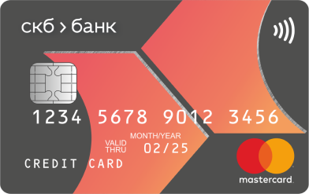
Imagine situation

Slide 4


Imagine situation

Slide 5



Imagine situation
БАНК

Slide 6
Imagine situation

Slide 7

Imagine situation

Slide 8
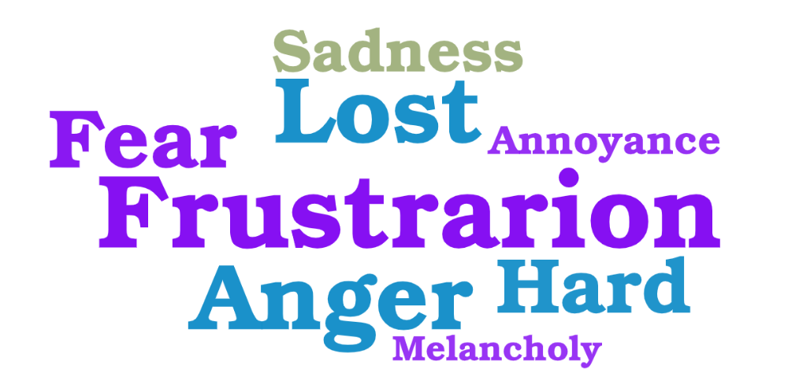
What would you feel?

Slide 9

WE HAVE THE SOLUTION!
Hello! My name is DeepLAW. I was created to serve people and help them with solving legal problems.

Slide 10
EASY TO USE
I have a problem with my card…
Here what the law says about your problem and what you should do next…

Slide 11


Multiple connections

Slide 12





Possible users

Slide 13
DeepLAW
IMPROVE THE WORLD TODAY

